Slide 1

ADOLESCENCE

Slide 2
ADOLESCENCE
Week 1
Lesson 1
45 minutter (Enkel lektion)

Slide 3
Introduction
Agenda
Introduction
Warm-Up: Vocabulary
Who is Jamie?
Reflection and Checking out

Slide 4
Introduction
LEARNING OBJECTIVES
I can use my prior knowledge about teenage life and crime to discuss the topic.
I can understand and use key vocabulary from the series.
I can give a short oral response in English about the series.

Slide 5
Vocabulary (15 min)
Create a document
Write the words of the week, translate them, and if there is time, write a sentence using the words in English.
Words of the week
Interrogation
Custody
Suspect
Victim
Manipulate
Evidence
Guilty
Innocent
Vocabulary
⚙ Teori anvendt: Retrieval-Based Learning

Slide 6
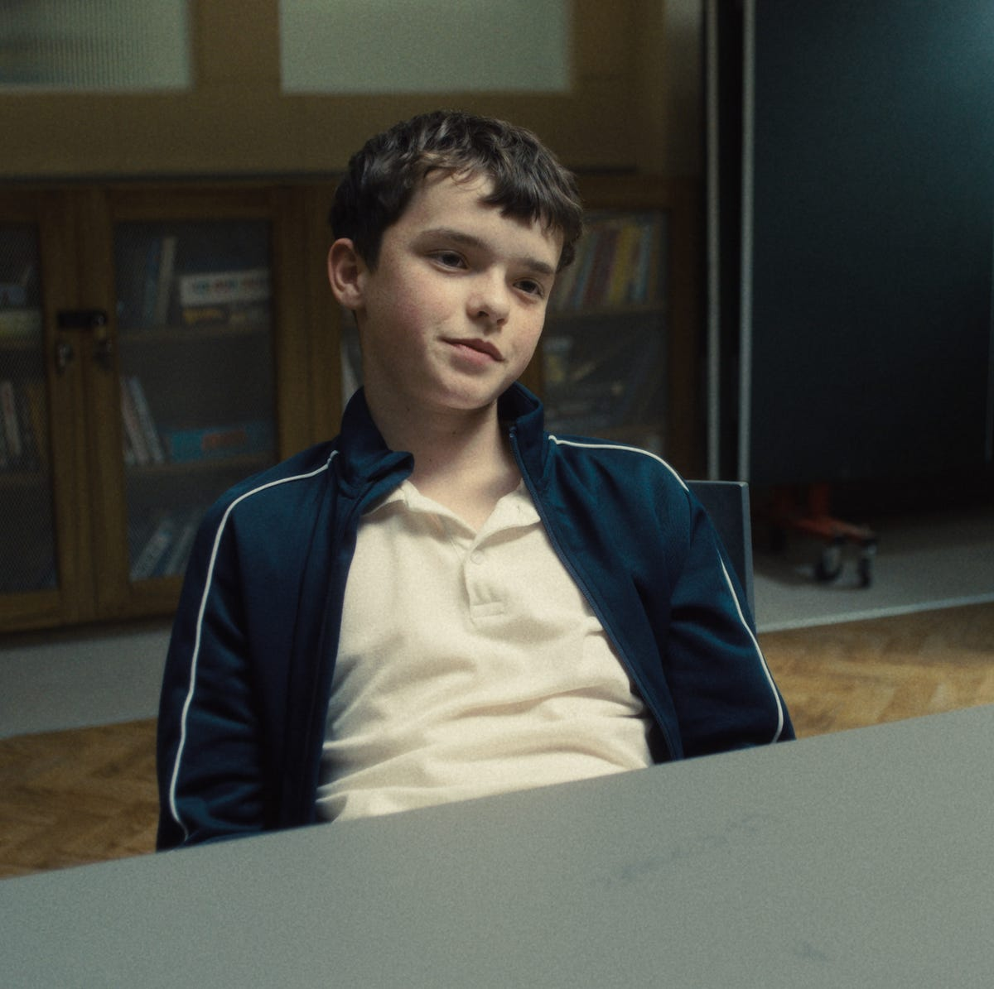
Who is Jamie?
Rewatch or watch the trailer for Adolescence.
Adolescence | Official Trailer | Netflix
Write 3–5 sentences in English: “Jamie seems… because…”. Try to use words from week 1 vocabulary.
Helping sentences: “He looks… / His body language shows… / I think he feels…”
After 5 mins: Students share their character description with a partner.
Who is Jamie?
⚙ Teori anvendt: Retrieval-Based Learning + TBLT (Real-World Outcome: peer communication)

Slide 7
Who is Jamie?
Who is Jamie?
Discuss in class:
What does Jamie’s body language reveal?
⚙ Teori anvendt: CALLA Lite (Elaboration + Selective Attention)

Slide 8
Reflection and Checking out
How did you experience Jamie?
Closing activity: “What question do you still have about Jamie?”
Reflection and Checking out
⚙ Teori anvendt: TBLT

Slide 9
ADOLESCENCE
Week 1
Lesson 2
1,5 time (double lektion)

Slide 10
Agenda
Introduction
Introduction
Warm-Up: Prediction Wall
Watch episode 1
'First Reactions’ — Oral Circle
Exit Task: Vocabulary Snapshot
Afterwards a little break

Slide 11
Introduction
Learning Goals
Understand the series’ central conflict and characters
Activate prior knowledge about teenage life and crime
Introduce key vocabulary from the series
Produce a short oral response in English

Slide 12
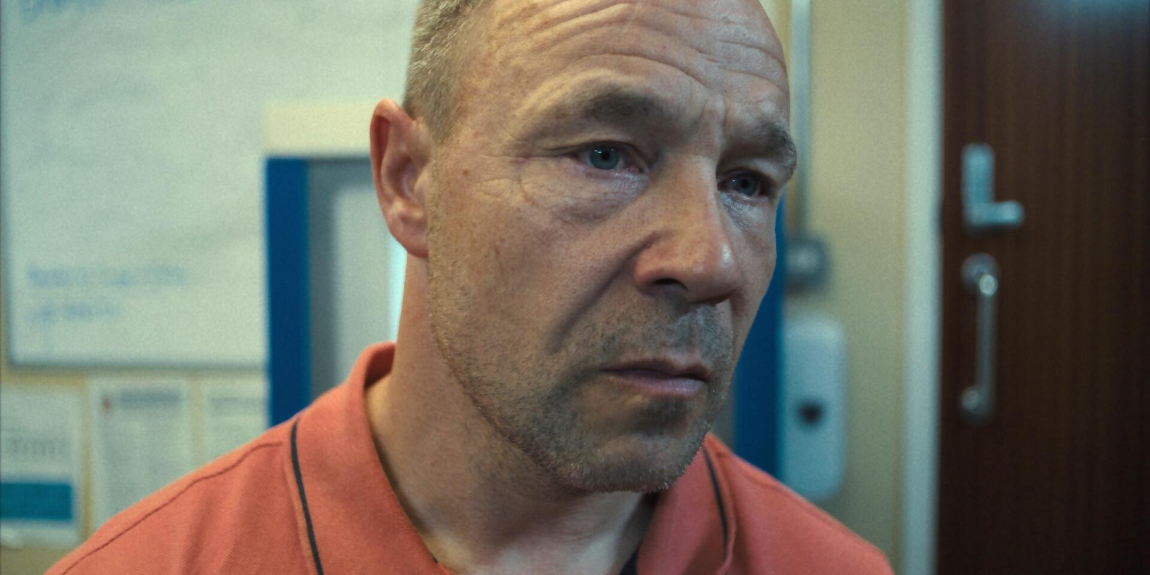
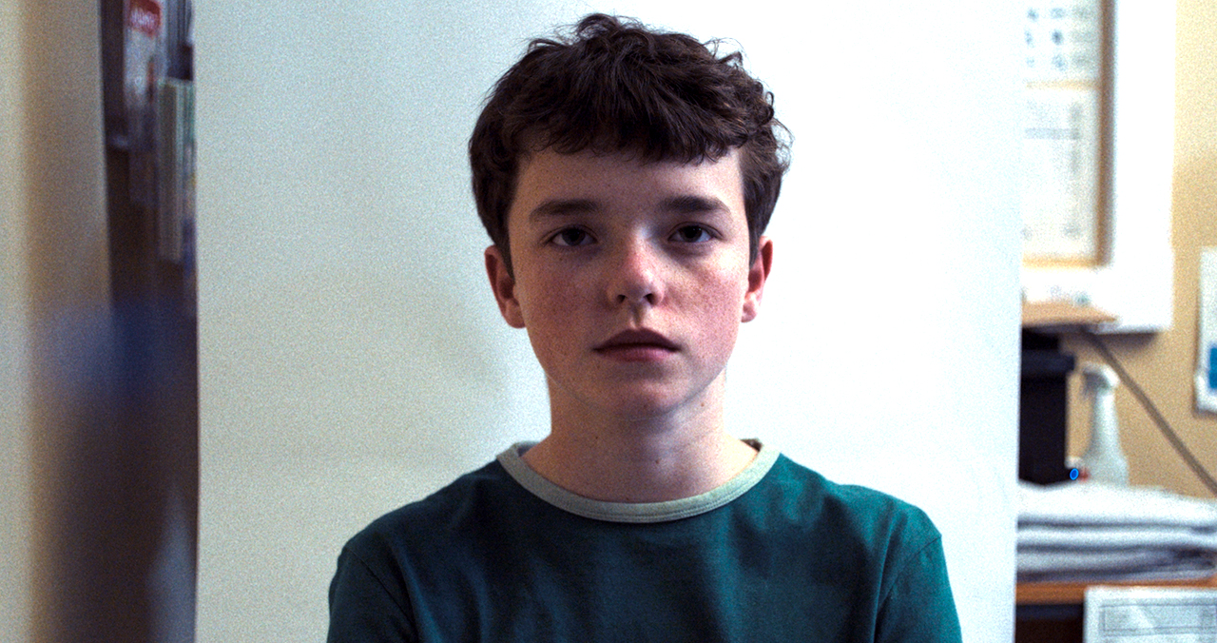
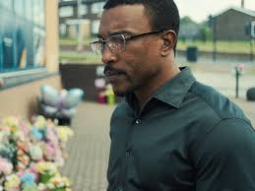
Warm-Up: Prediction Wall
Take 3 post-it note.
Write your answers in Danish or English.
Answer these two questions:
  Who do you think this person is?
  What do you think happens to them in the episode?
When you are finished, put your post-it note on the prediction wall.
Do not discuss the answers yet. We will talk about them later.
Warm-Up: Prediction Wall
⚙ Teori anvendt: Multimodal Input Flood (Mayer) + Cognitive Load-Optimized Instruction

Slide 13
Adolescence . Episode 1 . 30.17 min.
Netflix
Da en 13-årig dreng anklages for drabet på en klassekammerat, stiller hans familie, psykologen og efterforskeren alle det samme spørgsmål: Hvad skete der egentlig? Episode 1: Politiet trænger ind i Miller-familiens hjem. Teenageren Jamie anholdes og tages med til afhøring, men insisterer på, at han ikke har gjort noget forkert. (CFU)
Note: Jeg stopper episoden 3 gange, efter;
3.26 min
13.14 min
25 min
I skal notere ét ord eller én sætning, som forklarer den scene, jeg stopper ved.
Watch eps. 1
Link: mitcfu - Adolescence ( 1 )

Slide 14
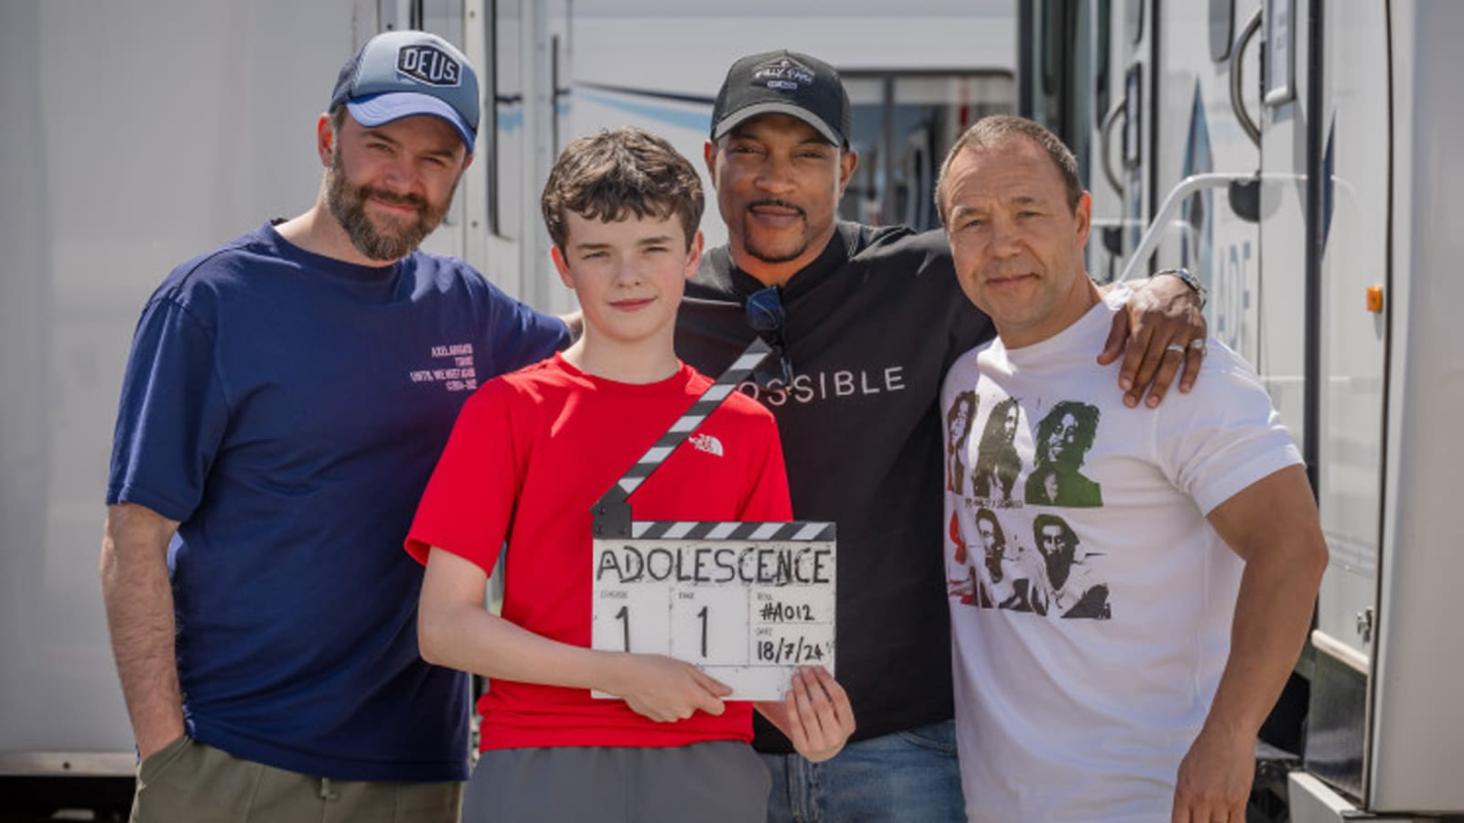
Break
Break
Kilde: Adolescence: How Stephen Graham’s Netflix hit pulled off jaw dropping 'one shot' filming technique - Prolific North

Slide 15
TASK: 'First Reactions’ (1/2)
Discuss the questions one at a time:
- Read your post-its
- How did you go?
First Reactions
⚙ Teori anvendt: TBLT (Real-World Outcome: spontan mundtlig reaktion) + Translanguaging

Slide 16
TASK: 'First Reactions’ (2/2)
Discuss the questions one at a time:
Q1 (Danish/English): How did you experience Jamies relationship to his father?
Q2 (primarily English): Describe Jamie in 3 words.
Q3 (primarily English): Who do you trust in this show — and why?
First Reactions
⚙ Teori anvendt: TBLT (Real-World Outcome: spontan mundtlig reaktion) + Translanguaging

Slide 17
Exit Task: Vocabulary Snapshot
Look at these keywords from the first episode:
2. Rank the words:
3. Write one sentence in English using the most important word.
Save the list — it will be used for retrieval next week.
Which 3 words are the MOST important for the series?
interrogation,
custody,
suspect,
victim,
manipulate,
evidence,
guilty,
innocent
Exit-task
⚙ Teori anvendt: Retrieval-Based Learning (spaced interleaving — introduktion)

Slide 18
ADOLESCENCE
Week 2
Lesson 1
45 minutter (Enkel lektion)

Slide 19
Introduction
Agenda
Introduction
Retrieval: Vocabulary
Critical analysis: The logic of the online world
Exit: Sentence cards

Slide 20
Introduction
Week 2
LEARNING OBJECTIVES
I can analyse the language used in interrogation scenes.
I can identify power relationships in dialogue.
I can write a character analysis in English.
I can recall vocabulary from Week 1.

Slide 21
Vocabulary
You have 5 minutes to write down what the words from last week mean.
Words of the week
Interrogation
Custody
Suspect
Victim
Manipulate
Evidence
Guilty
Innocent
Vocabulary
Alternativ eller færdig med ordforråd:
Skriv et resumé af alt det, du kan huske fra sidste uges afsnit af serien – enten på dansk eller engelsk.
⚙ Teori anvendt: Retrieval-Based Learning

Slide 22
Vocabulary
Share with a person in class, what the words mean
Words of the week
Interrogation
Custody
Suspect
Victim
Manipulate
Evidence
Guilty
Innocent
Vocabulary
⚙ Teori anvendt: Retrieval-Based Learning

Slide 23
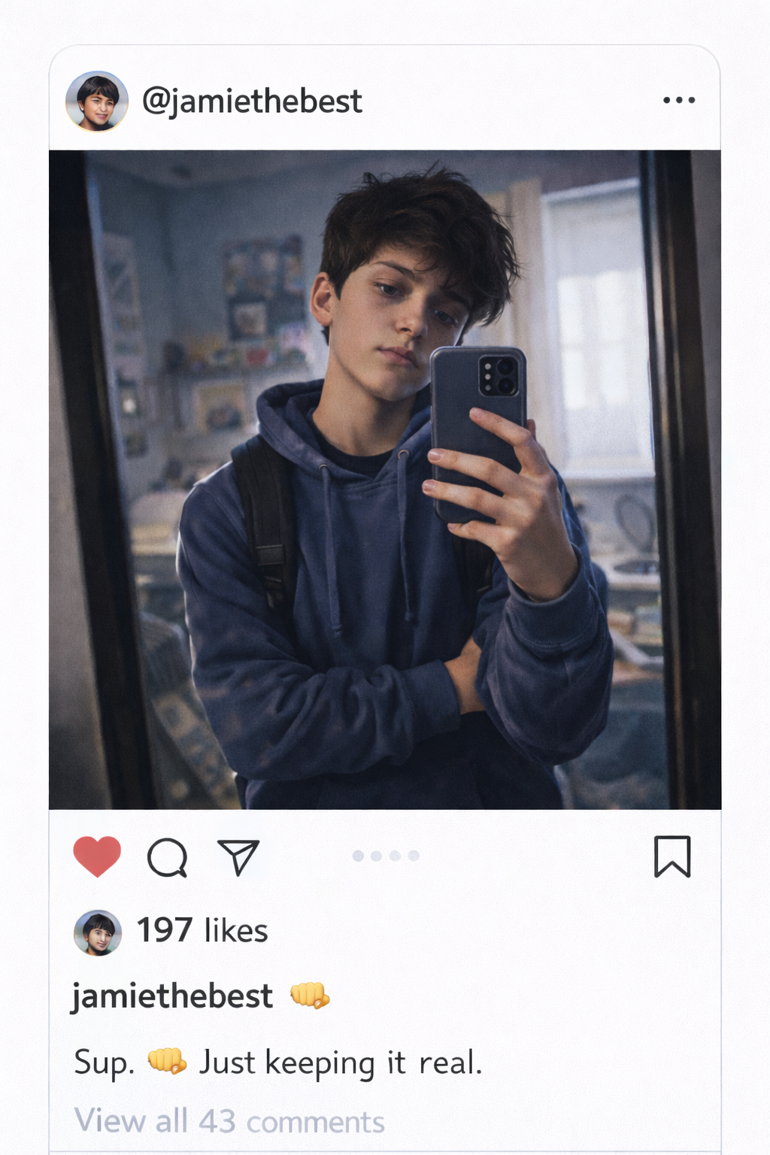
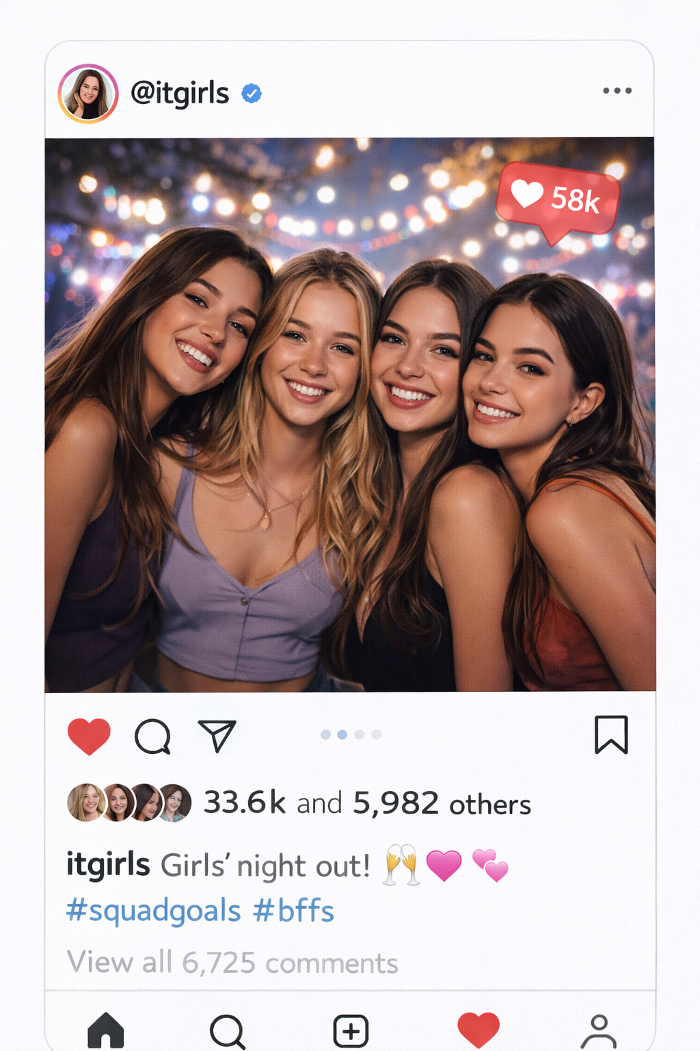
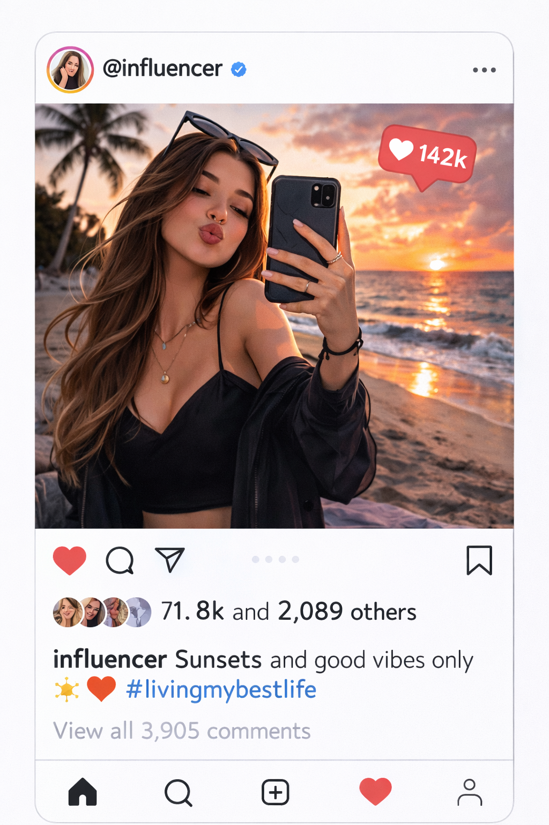
In small groups. Look at these 3 images and write down:
What you see in the images text and picture
'What is NOT written or seen in the post – what is implied?'
Helping sentence: 'This reminds me of... because...'
Critical analysis
⚙ Teori anvendt: CALLA (Inferencing + Critical Thinking) + Multimodal Input Flood
Notes:
Fotos lavede med chatGPT

Slide 24
10 min task (write in English):
On your PC, write 3 – 12 sentences answering the following:
When we see something on social media, do we really know what that person is thinking or going through in their life? Why or why not?
What can be implied (not directly written or shown) in a post, picture, or comment online?
How can social media influence the way young people see themselves or others?
Use this scaffold if helpful:
“I think that…”
“In my opinion…”
“One example could be…”
“This shows that…”
“Sometimes people post…, but they might actually…”
Exit Card
⚙ Teori anvendt: CALLA

Slide 25
ADOLESCENCE
Week 2
Lesson 2
1,5 time (double lektion)

Slide 26
Agenda
Introduction
Close Viewing: The Interrogation Scene
TASK: Language of Power — Written Analysis
World Café + Peer Response
Evaluation

Slide 27
Introduction
Week 2
LEARNING OBJECTIVES
I can analyse the language used in interrogation scenes.
I can identify power relationships in dialogue.
I can write a character analysis in English.
I am confident in words from Week 1.

Slide 28
Adolescence . Episode 1 . From 30.17 min until 63.14 min
Netflix
Da en 13-årig dreng anklages for drabet på en klassekammerat, stiller hans familie, psykologen og efterforskeren alle det samme spørgsmål: Hvad skete der egentlig? Episode 1: Politiet trænger ind i Miller-familiens hjem. Teenageren Jamie anholdes og tages med til afhøring, men insisterer på, at han ikke har gjort noget forkert. (CFU)
Note: Jeg stopper episoden 3 gange, efter;
38.45 min
43.49 min
54.27 min
I skal notere ét ord eller én sætning, som forklarer den scene, jeg stopper ved.
Close
Viewing
Link: mitcfu - Adolescence ( 1 )

Slide 29
Break
Close
Viewing
Kilde: Adolescence: How Stephen Graham’s Netflix hit pulled off jaw dropping 'one shot' filming technique - Prolific North

Slide 30
TASK: Language of Power — Written Analysis
Goal:
Work with a partner to analyse who has power in the conversation and how the language shows this.
Step 1: Work in Pairs
Discuss the question:
“Who has the power in the conversation, and why do you think that?”
Think about:
What the characters say
How they respond to each other
When the power in the conversation changes
Step 2: Write Your Analysis
Write 4–6 sentences in English together.
Sentence starters below to help you:
“The detective uses … to control the conversation.”
“Jamie responds by … which shows that he …”
“The power shifts when …”
Language of Power
⚙ Teori anvendt: TBLT + Cognitive Academic Language

Slide 31
World Café – Peer Feedback
Analyses are placed on tables around the classroom (one table per group).
One student stays as the host, while the other students rotate between tables (the guest).
At each table, the host will read their analysis, and the guest will write one comment in English on the host’s paper.
Only write positive observations or questions — no corrections.
World Café
⚙ Teori anvendt: TBLT + Cognitive Academic Language

Slide 32
Evaluation
How did you find Episode 1?
Has your view of Jamie changed?
Which three words would you use to summarise Episode 1?
Over the last two weeks, what has worked well in the lessons?
Evaluation
⚙ Teori anvendt: TBLT + Cognitive Academic Language

Slide 33
ADOLESCENCE
Week 3
Lesson 1
45 minutter (Enkel lektion)

Slide 34
Introduction
Agenda
Introduction
Warm-Up: Vocabulary
Incel?
Discussion

Slide 35
Introduction
LEARNING OBJECTIVES
I can use my prior knowledge about teenage life and crime to discuss the topic.
I can understand and use key vocabulary from the series.
I can give a short oral response in English about the series.

Slide 36
Vocabulary
Create a document
Write the words of the week, translate them, and if there is time, write a sentence using the words in English.
Words of the week
Confession
Coercion
Trauma
Grooming
Vulnerability
Facade
Vocabulary
⚙ Teori anvendt: Retrieval-Based Learning

Slide 37
Introduction
Incel?
Let's watch: Hvad er en incel? (ca. 7 min)
After watching the video, let’s discuss
• How do you understand the term Incel?
• Why do you think we had to watch this video?

Slide 38
ADOLESCENCE
Week 3
Lesson 2
1,5 time (double lektion)

Slide 39
Agenda
Introduction
TASK: Language of Power
Watch episode 3
Watch episode 3
Exit Ticket
Break

Slide 40
Language is Power
Introduction
Watch: How to Control Your Emotions During a Difficult Conversation: The Harvard Business Review Guide (6.39 min)
When have you last experienced a situation where you could use these tips, or imagine a situation where you could use them.
Brainstorm på dansk i 3 min, derefter skriver 2–3 engelske eksempler.
Find en anden gruppe og del jeres tanker.
Par-deling: 'In my experience, I could control my emotions by..’
Afslutter i plenum
⚙ Teori anvendt: TBLT (Transfer til real-world kontekst) + Translanguaging

Slide 41
Adolescence . Episode 3 . From 11.00 min until 22.45 min
Netflix
Da en 13-årig dreng anklages for drabet på en klassekammerat, stiller hans familie, psykologen og efterforskeren alle det samme spørgsmål: Hvad skete der egentlig? (CFU)
Note: Jeg stopper episoden 3 gange, efter;
13.52 min
16.30 min
19.35 min
I skal notere ét ord eller én sætning, som forklarer den scene, jeg stopper ved.
Episode 3
⚙ Teori anvendt: TBLT (Transfer til real-world kontekst) + Translanguaging

Slide 42
Break
Episode 3
Kilde: Adolescence: How Stephen Graham’s Netflix hit pulled off jaw dropping 'one shot' filming technique - Prolific North

Slide 43
Visual Note-Taking
Your Task
Watch: We will be viewing the last bit of episode 3
Note-taking: Use your "Visual Note-Taking" sheet. You will see two columns:
  What I SEE: Describe the actions, symbols, or events happening on screen.
  What I FEEL: Describe your emotional reaction or the "vibe" of the scene.
The Goal: Do not worry about perfect grammar or spelling. The focus is entirely on your understanding of the story and your personal reaction to it.
Episode 3
⚙ Teori anvendt: Multimodal Input Flood + Cognitive Load Optimization

Slide 44
Adolescence . Episode 3 . From 22.45 min until 50.25 min
Netflix
Da en 13-årig dreng anklages for drabet på en klassekammerat, stiller hans familie, psykologen og efterforskeren alle det samme spørgsmål: Hvad skete der egentlig? (CFU)
Note: Jeg stopper episoden 3 gange, efter;
25.13 min
34.16 min
47.10 min
Note-taking: Use your "Visual Note-Taking" sheet. You will see two columns:
  What I SEE: Describe the actions, symbols, or events happening on screen.
  What I FEEL: Describe your emotional reaction or the "vibe" of the scene
Episode 3
⚙ Teori anvendt: Multimodal Input Flood + Cognitive Load Optimization

Slide 45
Exit Ticket
1. Which character’s reaction in Episode 3 felt the most 'real' or relatable to you, and why?
Briefly describe a specific moment from the episode to support your choice.
2. In today’s episode, the protagonist vocalizes a major shift in his relationship with Katie.
In your own words, what was the primary cause of the tension, and does Jamie himself know?
3. If you had to give Episode 3 a title based on the themes we discussed today, what would it be?
Provide one reason why this title fits the events of the episode
Exit Ticket
⚙ Teori anvendt: Multimodal Input Flood + Cognitive Load Optimization

Slide 46
ADOLESCENCE
Week 4
Lesson 1
45 minutter (Enkel lektion)

Slide 47
Introduction
Agenda
Introduction
Warm-Up: Vocabulary
Start scene
Reflection and Checking out

Slide 48
Introduction
LEARNING OBJECTIVES
I can use my prior knowledge about teenage life and crime to discuss the topic.
I can understand and use key vocabulary from the series.
I can give a short oral response in English about the series.

Slide 49
Vocabulary
You have 10 mins.
Write the words of past and present week, translate them, and if there is time, write a sentence using the words in English.
Words of the week
Vocabulary
Confession
Coercion
Protagonist
Trauma
Grooming
Vulnerability
Façade
Perpetrator
Bystander
Empathy
Consequence
Tension
Radicalization
⚙ Teori anvendt: Retrieval-Based Learning

Slide 50
Watch eps. 3
We are going to watch the opening scene (11 min) of episode 3
Note: Jeg stopper episoden 2 gange, efter;
04.45 min
11 min
I skal notere ét ord eller én sætning, som forklarer den scene, jeg stopper ved.
Eps. 3
⚙ Teori anvendt: Retrieval-Based Learning

Slide 51
Reflection and Checking out
3 Questions
How do you think the rest of the episode will progress?
Name one word that we have worked with today or a word you think defines the TV-show?
Name a word that you think defines your generation (people your age)
Evaluation
⚙ Teori anvendt: Retrieval-Based Learning

Slide 52
ADOLESCENCE
Week 4
Lesson 2
1,5 time (double lektion)

Slide 53
Agenda
Introduction
TASK: Grooming & Manipulation
Evidence Board: Build
Evidence Board: Present
Exit Ticket
Break

Slide 54
Grooming & Manipulation
Introduction
Recap: In Week 3 we watched a video about incels.
Task: In pairs, discuss how Jamie’s online world may have shaped him.
This week’s words: confession, coercion, trauma, grooming, vulnerability, facade.
Write 3–4 sentences: “Jamie’s online world shaped him because…”
Starter: “He was vulnerable because…”
Share with another pair.
⚙ Teori anvendt: CALLA (Elaboration) + TBLT (Real-World Outcome: peer discussion)

Slide 55
Evidence Board — Step 1: Choose Your Scene
In groups of 3–4, look back through your notes from the last two lessons on Episode 3.
Choose ONE scene that best shows a moment of pressure, manipulation, or vulnerability.
Which scene it is (describe briefly)
Who is involved
Why it stood out to your group
Use this week’s vocabulary (confession, coercion, trauma, grooming, vulnerability, facade) in your explanation.
Evidence Board
⚙ Teori anvendt: CALLA (Selective Attention) + Retrieval-Based Learning

Slide 56
Break
Evidence Board
Kilde: Adolescence: How Stephen Graham’s Netflix hit pulled off jaw dropping 'one shot' filming technique - Prolific North

Slide 57
Evidence Board: Build It
Your Task
Create a small “Evidence Board” (poster or drawing) for the scene your group chose.
Include:
- The scene you chose (in a few words)
- One key vocabulary word that describes it
- One quote or moment, in your own words
Add a small drawing or symbol that captures the mood of the scene.
  Time: 15 minutes to plan and draw.
The Goal: Focus on your understanding of Jamie’s story and your group’s interpretation — not on perfect drawing or grammar.
Evidence Board
⚙ Teori anvendt: Multimodal Input Flood + Cognitive Load-Optimized Instruction

Slide 58
Evidence Board — Gallery Walk
Place your Evidence Board on your table.
Half the group stays to present (2 min each); the other half walks around and reads/listens.
Guests write one comment or question in English on a sticky note.
Switch roles after 5 minutes so everyone gets to present.
Only positive observations or questions — no corrections.
Evidence Board
⚙ Teori anvendt: TBLT (Real-World Outcome: peer presentation) + World Café method

Slide 59
Exit Ticket
1. What is one new thing you understood about Jamie after building your Evidence Board?
Give one concrete detail from your group’s discussion that helped you understand this.
2. Which word from this week’s vocabulary (confession, coercion, trauma, grooming, vulnerability, facade) feels most important to Jamie’s story? Why?
3. What are you curious to find out when we start Episode 4 next lesson?
Exit Ticket
⚙ Teori anvendt: Retrieval-Based Learning + Reflection

Slide 60
ADOLESCENCE
Week 5
Lesson 1
45 minutter (Enkel lektion)

Slide 61
Introduction
Agenda
Introduction
5-question worksheet
Start scene
Reflection

Slide 62
Introduction
LEARNING OBJECTIVES
I can use my prior knowledge about teenage life and crime to discuss the topic.
I can understand and use key vocabulary from the series.
I can give a short oral response in English about the series.

Slide 63
Power of the Pen
Work alone or in pairs and answer the 5-part worksheet
5-part worksheet
Part 1: Vocabulary
Part 2: Critical Evaluation (The "Why")
Part 3: Match the Headlines
Part 4: Written Response
Part 5: Analysing the real world
Time: 30 min
Power of the Pen
⚙ Teori anvendt: CALLA (Critical Evaluation) + TBLT (real-world literacy task)

Slide 64
Watch eps. 4
We will watch the first 12 min of eps. 4
I am going to stop episode 4 after 4.12 min, and you are going to answer the task “Inner Monologue”.
Inner Monologue:
Write exactly two sentences of what that father is thinking but not saying.
Eps. 4
⚙ Teori anvendt: CALLA (Critical Evaluation) + TBLT (real-world literacy task)

Slide 65
Reflection
1 Questions
What do you think will happen at the end of the episode?
Reflection
⚙ Teori anvendt: Retrieval-Based Learning

Slide 66
ADOLESCENCE
Week 5
Lesson 2
1,5 time (double lektion)

Slide 67
Agenda
Introduction
TASK: The Untold Story
Watch episode 4
Watch episode 4
Exit Ticket
Break

Slide 68
The Untold Stories
The Big Question: Whose perspective have we NOT heard in the show yet?
1. Pair Brainstorm (2–3 mins)
Talk with your partner (Danish or English is fine).
Identify characters "missing" from the narrative.
Examples: The victim, the victim’s family, or Jamie’s sister.
2. Step Into Their Shoes
Choose one person from your brainstorm and consider: What would they say about the murder and the whole situation?
3. The Writing Task
Write 4–6 sentences in English from that person's perspective.
Goal: Try to capture their specific emotions, secrets, or side of the story.
Quick Tips for Your Writing:
Use "I" statements: Write as if you are that person.
Think about tone: Is this person angry, grieving, confused, or defensive?
Focus on the "Why": Why haven't we heard from them until now?
The Untold Stories
⚙ Teori anvendt: TBLT + CALLA (perspektivtagning) + Translanguaging

Slide 69
Prediction Checkpoints
We are going to watch 10-minutes of episode 4.
Before we start, write a "micro-prediction“.
Micro-prediction
Write ca. 10 words and 2-3 predictions of what you think will happen the next 10 minutes.
After 10 minutes
After 10 minutes mark your predictions with
a + if they were right,
a - if they were wrong,
a ! if a twist surprised you
Episode 4
⚙ Teori anvendt: TBLT (Transfer til real-world kontekst) + Translanguaging

Slide 70
Adolescence . Episode 4 . From 12.00 min until 22.08 min
Prediction Checkpoints
We are going to watch 10-minutes of episode 4.
Before we start, write a "micro-prediction“.
Micro-prediction
Write ca. 10 words and 2-3 predictions of what you think will happen the next 10 minutes.
After 10 minutes
After 10 minutes mark your predictions with
a + if they were right,
a - if they were wrong,
a ! if a twist surprised you
Episode 4
⚙ Teori anvendt: TBLT (Transfer til real-world kontekst) + Translanguaging

Slide 71
Break
Episode 4
Kilde: Adolescence: How Stephen Graham’s Netflix hit pulled off jaw dropping 'one shot' filming technique - Prolific North

Slide 72
Adolescence . Episode 4 . From 22.08 min until 58 min
The end of the episode will be stopped 3 times, each time with a new assignment.
After 25.10 min
Question Logs (No Answers Allowed)
Instead of taking notes on what happened, write down three questions you would ask the employee if they could interview them right now.
After 35.16 min
Social Media "Live-Tweet"
Write a Social Media post. “Post" a short, 280-character reactions or hashtags in real-time to the scene you just watched.
After 55.25 min
The "Freeze-Frame" Sketch
You have 60 seconds to do a "lightning sketch" of the frame/scene.
Episode 4
⚙ Teori anvendt: Multimodal Input Flood + Cognitive Load Optimization

Slide 73
Exit Ticket
Main character
Who do you feel is the main character of the show? Explain why and give examples.
2. Justice or Just the Law?
Do you feel the ending was just (fair), or was it simply the result of a flawed system? Use one example from the episode to support your opinion.
3. The Aftermath
If there were a "One Year Later" scene, what would the main character's life look like? (Describe their emotional state or situation).
Exit Ticket
⚙ Teori anvendt: Multimodal Input Flood + Cognitive Load Optimization

Slide 74
Further Reading & Discussion
Can we ever understand the ‘whydunnit’ of Adolescence? | Seen & Unseen

